Slide 1
Introduction to R Workshop
Session 5
Statistical Analysis in R
July 17, 2020

Slide 2
July 16 2020 | Session | Instructor
1:00 pm - 1:30 pm | Instructor Introductions, Introduction to technology | Amrom Obstfeld
1:30 pm - 2:15 pm | Introduction to R and RStudio | Joe Rudolf
2:30 pm - 3:15 pm | R basics for Reproducible Reporting | Patrick Mathias
3:30 pm - 5:00 pm | Data Visualization in R | Stephan Kadauke
July 17 2020
1:00 pm - 2:30 pm | Data Transformation | Amrom Obstfeld
2:45 pm - 4:15 pm | Statistical Analysis in R | Dan Herman
4:30 pm - 5:00 pm | Advanced Reporting in R | Patrick Mathias
Notes:
In this block, we’ll dive deeper into one or the main generators of knowledge and understanding in data analysis: visualization.

Slide 3
Objectives
Be able to…
Calculate a summary statistic for a variable using `summarize`
Calculate of summary statistic for a variable separately for a group of observations, using `group_by` and `summarize`
Perform a simple test for association

Slide 4
Typical Data Science Pipeline
From R for Data Science (https://r4ds.had.co.nz/introduction.html)
Notes:
In this session we will focus on modeling. But, in the process, we will do a lot more data transformation

Slide 5
Summarize()

Slide 6
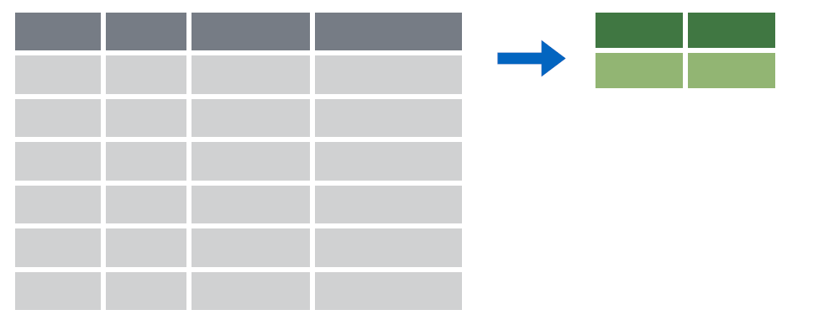

summarize()
Make summaries of your data
Notes:
Apply a function (or functions) to all observations of a variable and return a single value, or summary.

Slide 7
summarize()
Make summaries of your data
covid_testing %>%
summarize(new_variable = calculation)
name for new variable
Value or function

Slide 8
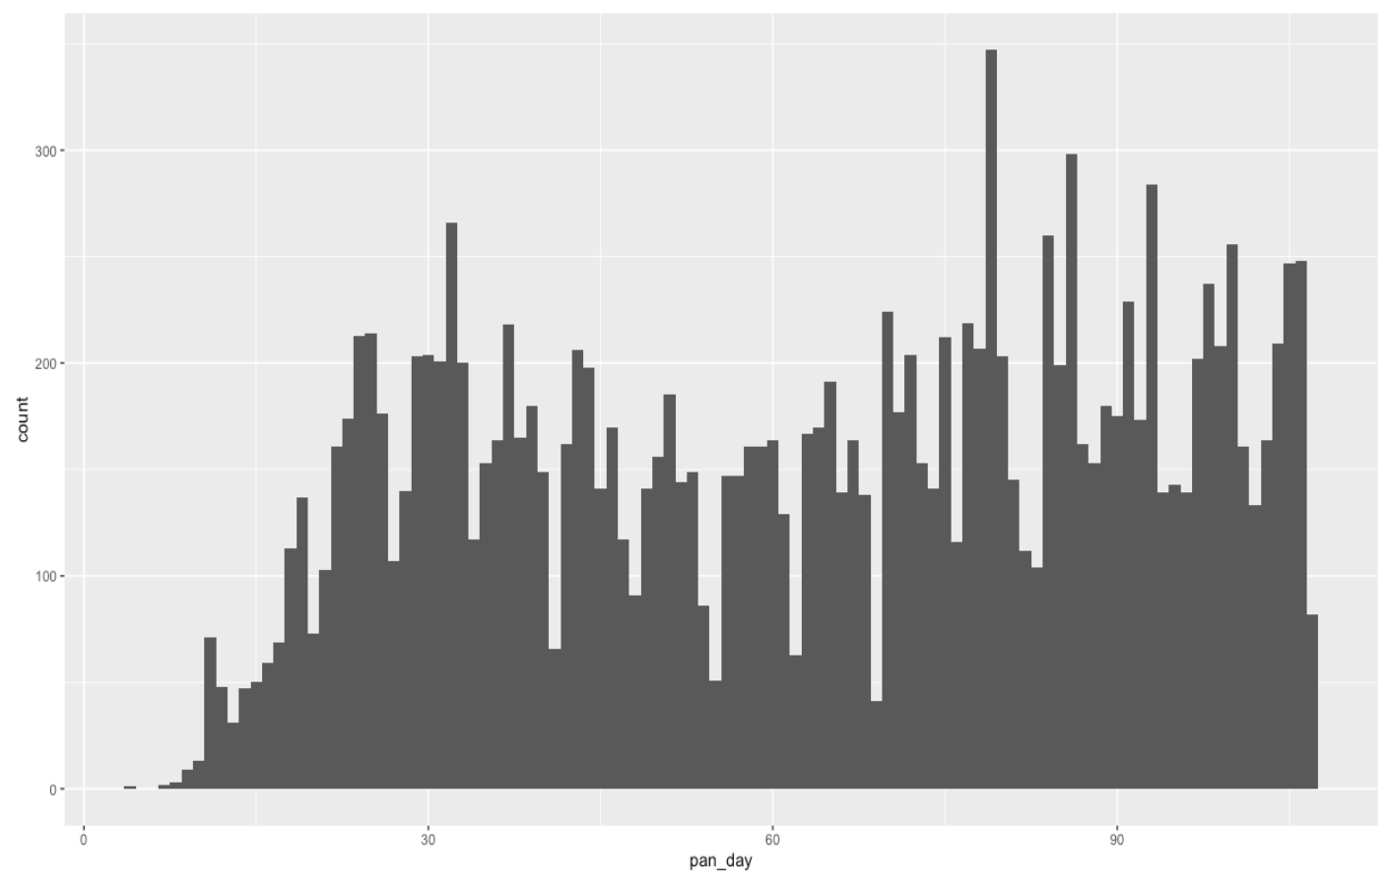
Q: How many tests are ordered per day?

Slide 9
summarize()
function that returns number of observations
Make summaries of your data
covid_testing %>%
select(mrn, pan_day) %>%
head(4) %>%
summarize(order_count = n())
mrn | pan_day
5001412 | 4
5000533 | 7
5009134 | 7
5008518 | 8
order_count
4
Notes:
n() returns the number of observations or rows for a data frame.
Note, that to simplify the data frame, we first will select 2 variables and include the first 4 observations.

Slide 10
summarize()
function that returns number of distinct values
Make summaries of your data
covid_testing %>%
select(mrn, pan_day) %>%
head(4) %>%
summarize(order_count = n(),
day_count = n_distinct(pan_day))
mrn | pan_day
5001412 | 4
5000533 | 7
5009134 | 7
5008518 | 8
order_count
4
day_count
3
Notes:
n_distinct() counts the number of distinct, or unique, observations. So, while there are 4 rows, there are only 2 distinct patient_id’s.

Slide 11
Your Turn 1
Add onto the code in the above chunk to calculate:
a) Mean count of orders per `pan_day`
b) Mean count of orders per clinic
Notes:
TODO: Change to 5 minutes

Slide 12
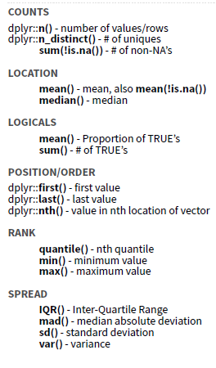
Notes:
There are many native summary functions from base R and dplyr.

Slide 13
summarize() examples
Last pandemic day (in data)
Median turnaround time
Notes:
n_distinct() counts the number of distinct, or unique, observations. So, while there are 4 rows, there are only 2 distinct patient_id’s.

Slide 14

Your Turn 2
Consider:
How would you calculate the median number of orders per day?
Notes:
The mean was a special case, because it can be calculated using summarize and not explicitly knowing which order is from which patient. But, to calculate the median (find the mid-point of the observations), we need to be able to assess each patient’s observations separately.

Slide 15
group_by()

Slide 16
group_by()
Notes:
Group_by is a challenging function to master, but extremely powerful. It is one of those tools that once you understand how to use, you cannot possibly go back to live without it.
The idea is simple. I have one big data frame and I want to break the observations up into several groups. Then, I’m going to “look at” those groups separately.

Slide 17
group_by()
Grouping observations based on a specific variable’s values
covid_testing %>%
group_by(variable)
name of variable to group by

Slide 18
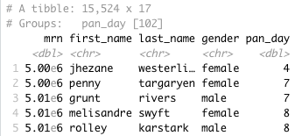
group_by()
Group observations by pan_day
covid_testing %>%
group_by(pan_day)
Notes:
We can see that the resulting object has 15,524 rows that are broken up into 102 groups. Inherently, this means there are 102 distinct `pan_day`’s. Some of these groups will have a single observation. Many of these groups will have more than one observation.

Slide 19
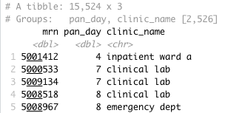
group_by()
Group observations by `pan_day` and `clinic_name`
covid_testing %>%
select(mrn, pan_day, clinic_name) %>%
group_by(pan_day, clinic_name)
Notes:
We can see that the resulting object has 15,524 rows that are broken up into 102 groups. Inherently, this means there are 102 distinct `pan_day`’s. Some of these groups will have a single observation. Many of these groups will have more than one observation.

Slide 20
group_by() %>% summarize()

Slide 21
group_by()
%>%
summarize()
Make summaries of your data by group
Notes:
Just like we can apply summarize() to a full data frame, we can apply summarize() to each group separately.

Slide 22
group_by() %>% summarize()
Make summaries of your data
covid_testing %>%
summarize(order_count = n())
mrn | pan_day
5001412 | 4
5000533 | 7
5009134 | 7
5008518 | 8
order_count
4
Notes:
n() returns the number of observations or rows for a data frame.
Note, that to simplify the data frame, we first will select 2 variables and include the first 4 observations.

Slide 23
group_by() %>% summarize()
Make summaries of your data
covid_testing %>%
group_by(pan_day) %>%
summarize(order_count = n())
mrn | pan_day
5001412 | 4
5000533 | 7
5009134 | 7
5008518 | 8
pan_day
4
7
8
9
order_count
1
2
3
9
Notes:
n() returns the number of observations or rows for a data frame.
Note, that to simplify the data frame, we first will select 2 variables and include the first 4 observations.

Slide 24
Your Turn 3
Calculate:
a) The median turnaround time for each day
c) (*Extra*) The median number of orders per day

Slide 25
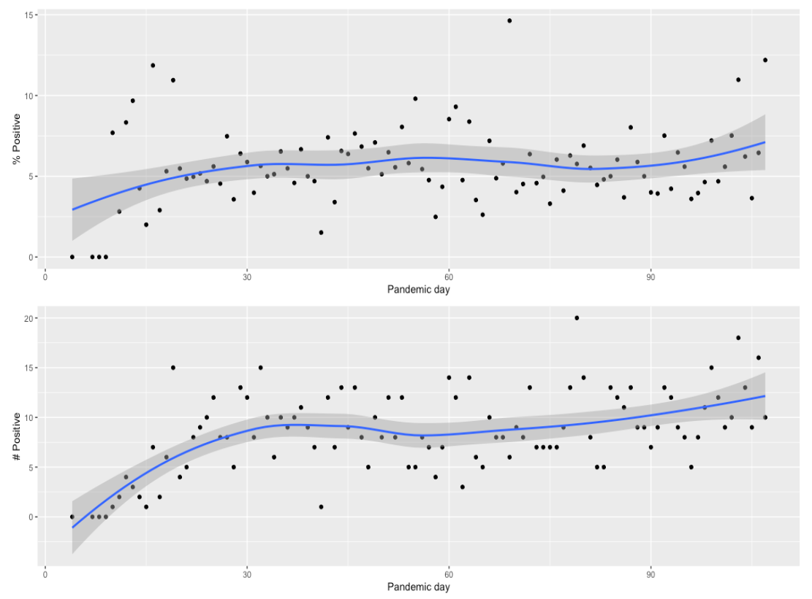
group_by() %>% summarize(): Example
Notes:
n_distinct() counts the number of distinct, or unique, observations. So, while there are 4 rows, there are only 2 distinct patient_id’s.

Slide 26
Stats

Slide 27
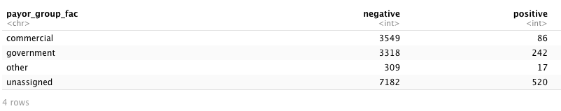
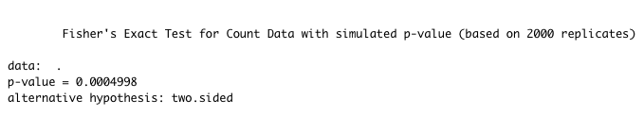
Q: Is there an association between insurance and SARS-CoV-2 RT-PCR positivity?
data %>%
fisher.test(simulate.p.value = T)

Slide 28
function that flexibly assigns values
Data wrangling - 1
covid_testing_2 <- covid_testing %>%
mutate(payor_group_fac = case_when(
is.na(payor_group) ~ "unassigned",
payor_group %in% c("charity care", "medical assistance",
"self pay", "other") ~ "other",
TRUE ~ payor_group)
) %>%
filter(result %in% c("positive", "negative"))
Notes:
n() returns the number of observations or rows for a data frame.
Note, that to simplify the data frame, we first will select 2 variables and include the first 4 observations.

Slide 29
Data wrangling - 2
Remove groupings
# Generate counts
tmp_table_tall <- tmp %>%
group_by(payor_group_fac, result) %>%
summarize(n = n()) %>%
ungroup()
tmp_table_tall
# Pivot from tall to wide table
tmp_table_wide <- tmp_table_tall %>%
spread(key = "result", value = "n") %>%
select(-payor_group_fac)
tmp_table_wide
Maps key values to separate columns
Notes:
n() returns the number of observations or rows for a data frame.
Note, that to simplify the data frame, we first will select 2 variables and include the first 4 observations.

Slide 30
Association testing
Notes:
n() returns the number of observations or rows for a data frame.
Note, that to simplify the data frame, we first will select 2 variables and include the first 4 observations.

Slide 31
Your Turn 4
What is the relative odds of a positive test result between patients with government or commercial insurance?

Slide 32
What Else?

Slide 33
Example: Logistic regression
Notes:
n() returns the number of observations or rows for a data frame.
Note, that to simplify the data frame, we first will select 2 variables and include the first 4 observations.

Slide 34
Objectives
Be able to…
Calculate a summary statistic for a variable using `summarize`
Calculate of summary statistic for a variable separately for a group of observations, using `group_by` and `summarize`
Perform a simple test for association

